Slide 1
Company Presentation
Green | Lean | Smart

Slide 2
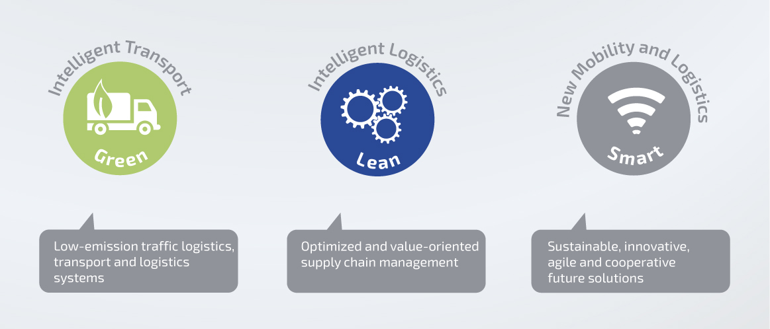
LNC Solutions

Slide 3
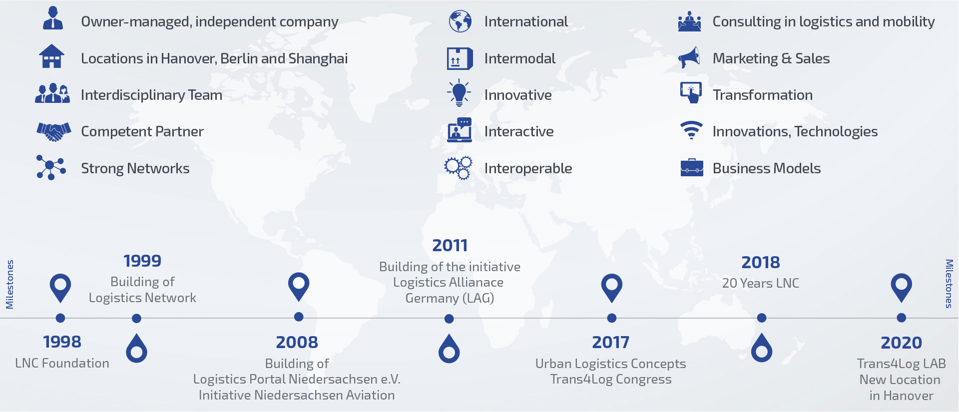
Benefit from more than 23 Years of Market Experience

Slide 4
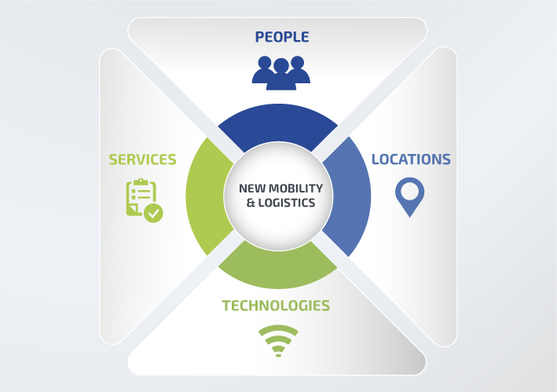
LNC Mission: #LogisticsConnected
Mobility and services
Innovations and transformation
Technologies and security
Systems and Services
Emission and sustainability

Slide 5
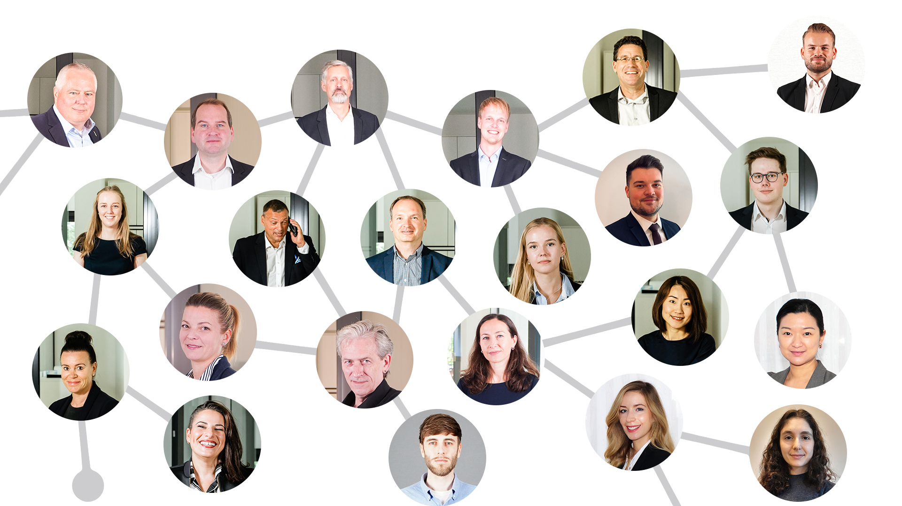
Team LNC
International > worldwide
Multilingual > 6 languages
Interdisciplinary - Economics - Logistics - Business Administration - Spatial Planning - Economic Engineering - Tourism - Media - Event - Forestry
Characteristics - competent - experienced - agile - networked - solution oriented

Slide 6
LNC Business Areas
Core services
We provide customized consulting!
We create market access!
We promote your projects!
We create target group specific solutions!
LNC ECO System
Consulting Networks Marketing
>
<
>
<

Slide 7
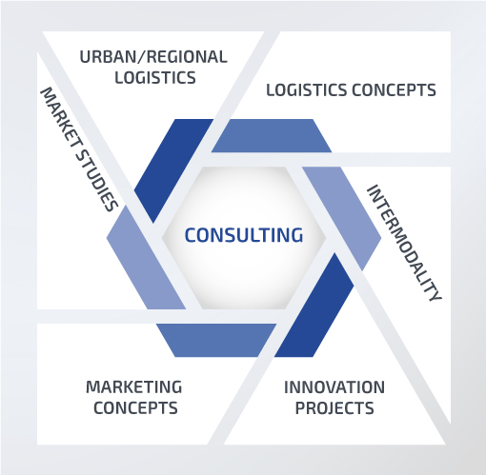
Consulting Services
Selection of Reference Projects:
Investigation of changes in commercial delivery transport and its effects on urban logistics
Feasibility study bundling of general cargo transports starting from the freight village (GVZ) Großbeeren
Development of a commercial transport concept for the Tempelhof-Schöneberg district of Berlin
Strategy aerospace initiative Lower Saxony
Study on the logistics industry in the Free State of Saxony
City logistics concepts (Bielefeld, Osnabrück, Frankfurt/Main, Lindau)
Marktspiegel Logistik - Logistics-related investments in Lower Saxony

Slide 8
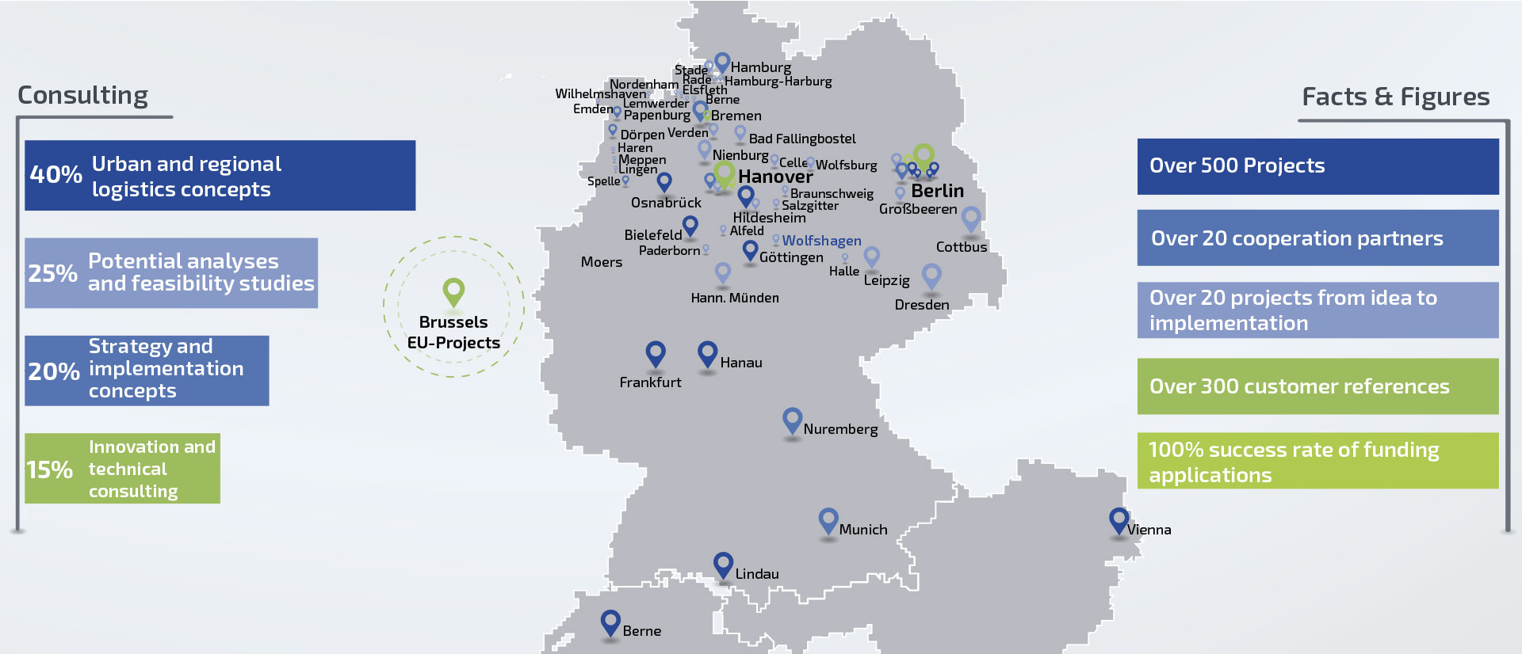
Consulting Projects on behalf of Customers

Slide 9
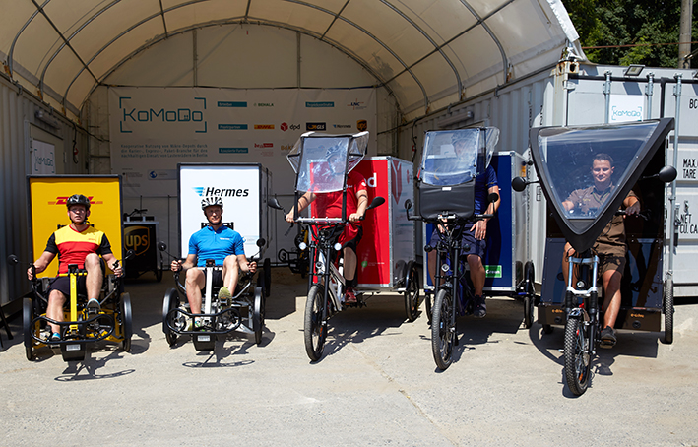
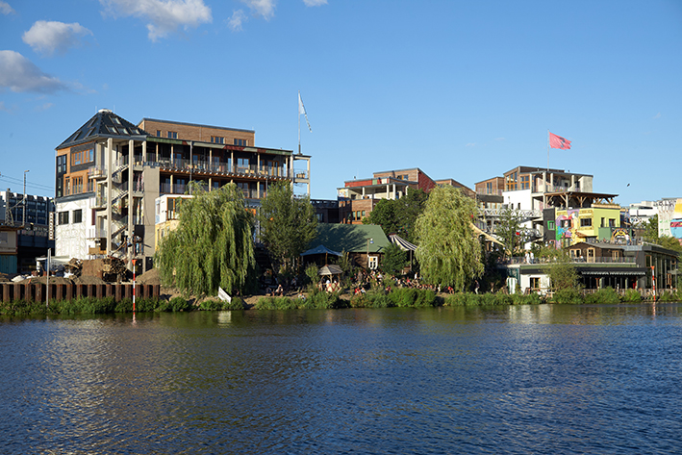
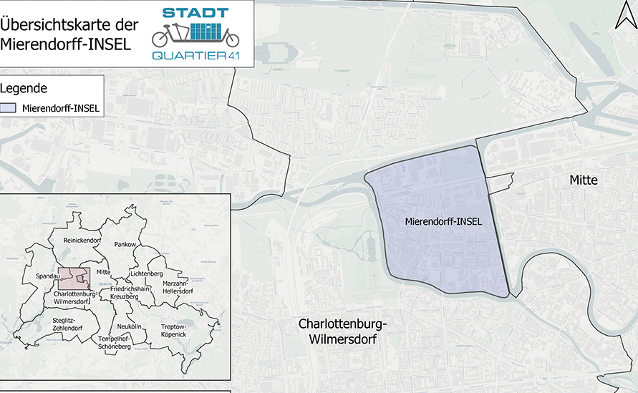
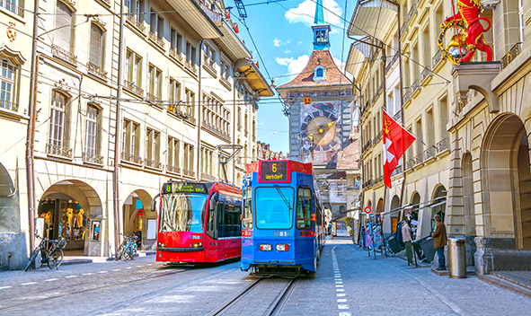
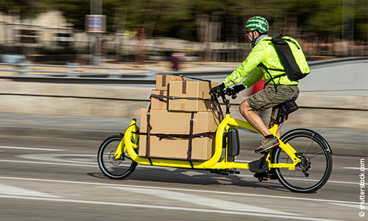
Excerpt References "Urban Logistics"
Project KoMoDo Berlin (2017-2018)
www.komodo.berlin
Urban Quarter 4.0 Project
(2017-2020), Holzmarkt Areal Berlin
www.urbanelogistik.de
Urban Quartier 4.1 Project
(2020-2022), Mierendorf-Island Berlin
www.urbanelogistik.de
Urban Logistics Project in Bern (2018)
Further city logistics concepts for Berlin, Bielefeld, Osnabrück, Hildesheim, Vienna, Lindau, Frankfurt.

Slide 10
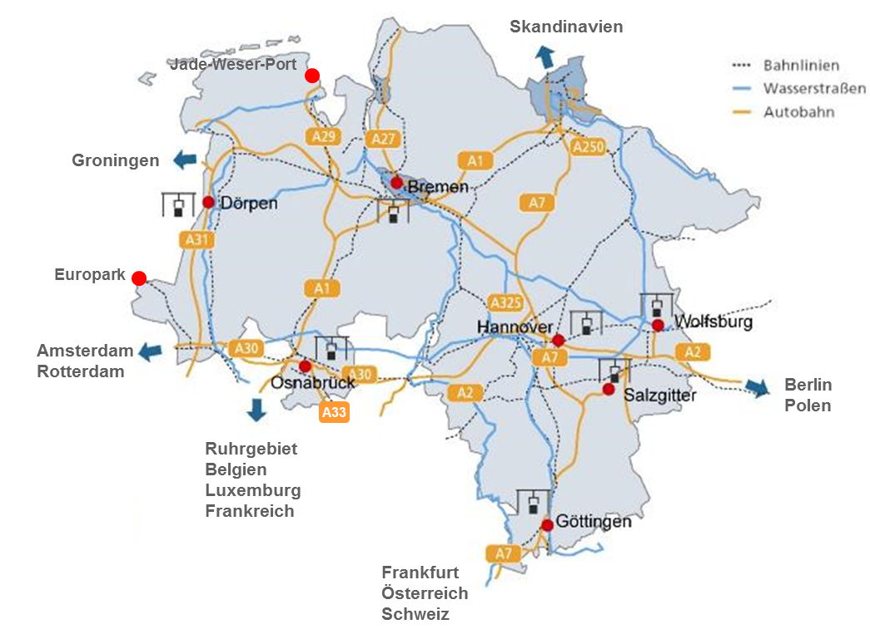
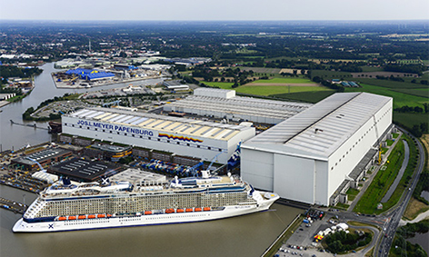
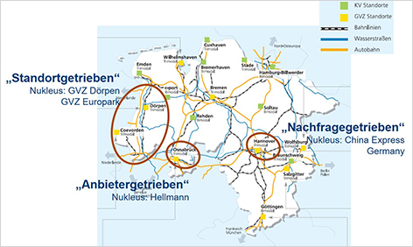
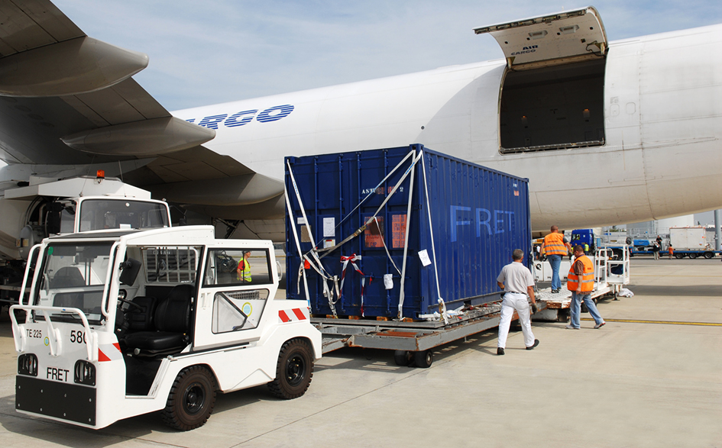
Excerpt References "Intermodality”
Moderation of the WG Freight Transport Centers Lower Saxony/Bremen (since 2002)
Feasibility study for a logistics and supply park MEYER WERFT (2017)
Status quo - analysis of Silkroad projects and presentation of requirement profiles of stakeholders in Lower Saxony (2017)
Multifunctional logistics facility at the GVZ Dörpen site (2017)
Marktspiegel Logistik - Logistics-related investments in Lower Saxony (since 2005)
HAJ SMART FREIGHTER: Air freight connection between Hanover, Germany and China (2020)

Slide 11
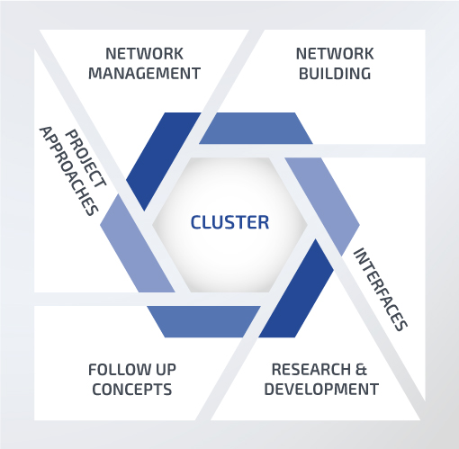
Clusters & Networks
Logistics Alliance Germany since 2010 PPP with BMVI and German logistics industry
Lower Saxony Aviation since 2008
State of Lower Saxony
Logistics Portal Niedersachsen e.V.
since 2008
Lower Saxony logistics industry
KoMoDo Cooperative use of micro depots funded by the Federal Ministry for the Environment, Nature Conservation and Nuclear Safety (BMU), national climate protection initiative

Slide 12
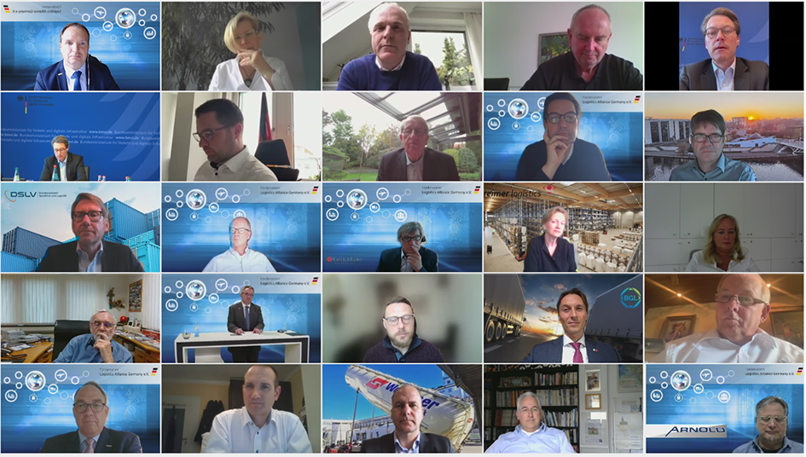
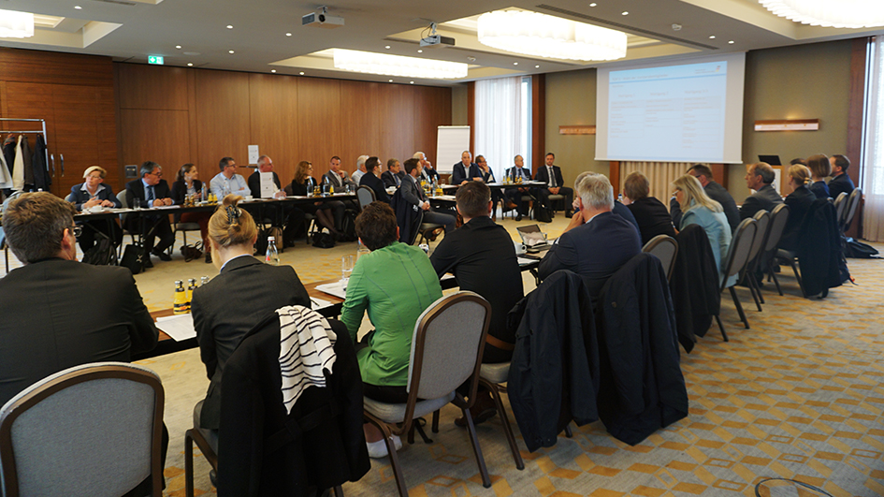
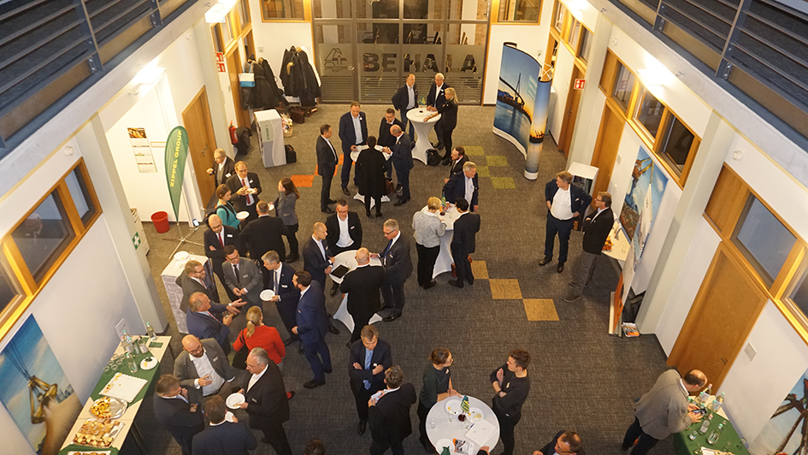
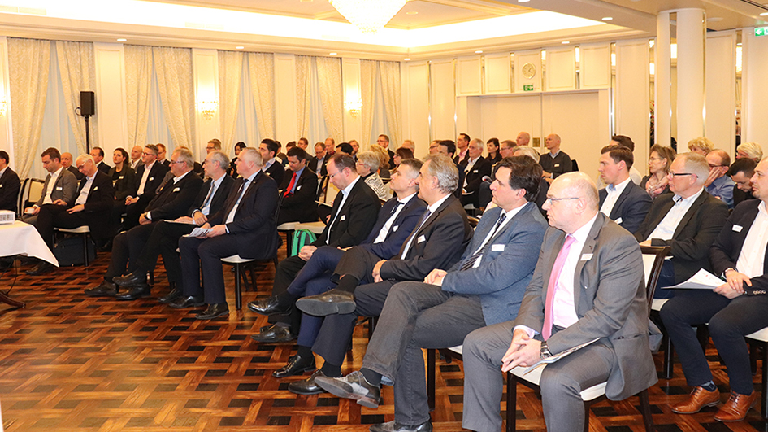
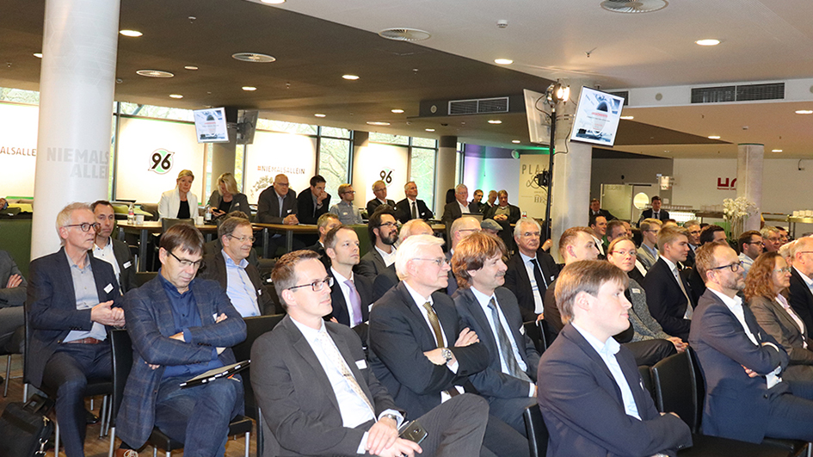
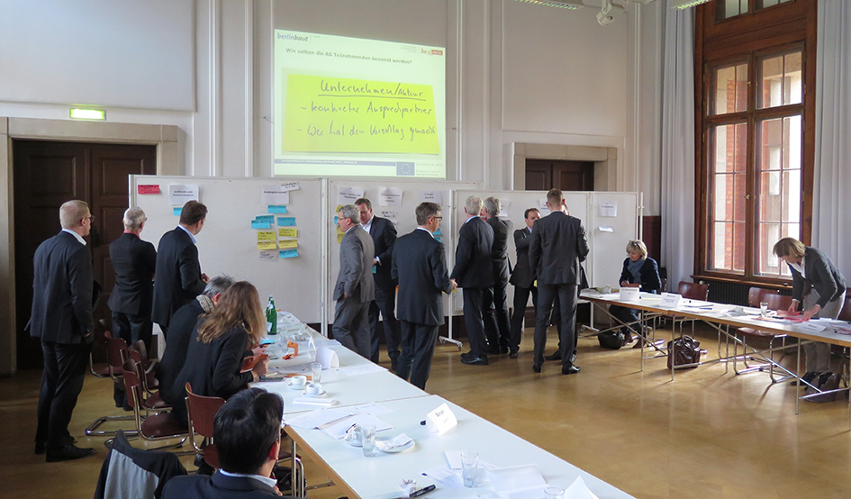
Excerpt References "Clusters & Networks
Fireside Evening of the Förderverein LAG e.V. (2021), Digital Event
General meeting of the Förderverein LAG e.V. (2019)
Annual network meeting of the Förderverein LAG e.V. (2019)
Quo Vadis - networking event of
LPN e.V. (2019)
Annual network meeting of the state initiative Niedersachsen Aviation (2019)
Moderation of the workshop series
"New edition of the IWVK“ (2018-2019)

Slide 13
Communication
Selection of References:
Trans4Log Congress since 2017
Trade event on the topic of digitalization and logistics 4.0
ILA Berlin Airshow
The largest aerospace exhibition
in Europe
transport logistic Munich
The world's leading trade fair for logistics, mobility, IT and supply chain management
Hypermotion Frankfurt
The multimodal innovation platform around the future topic of mobility and logistics in Green Cities and Smart Regions

Slide 14
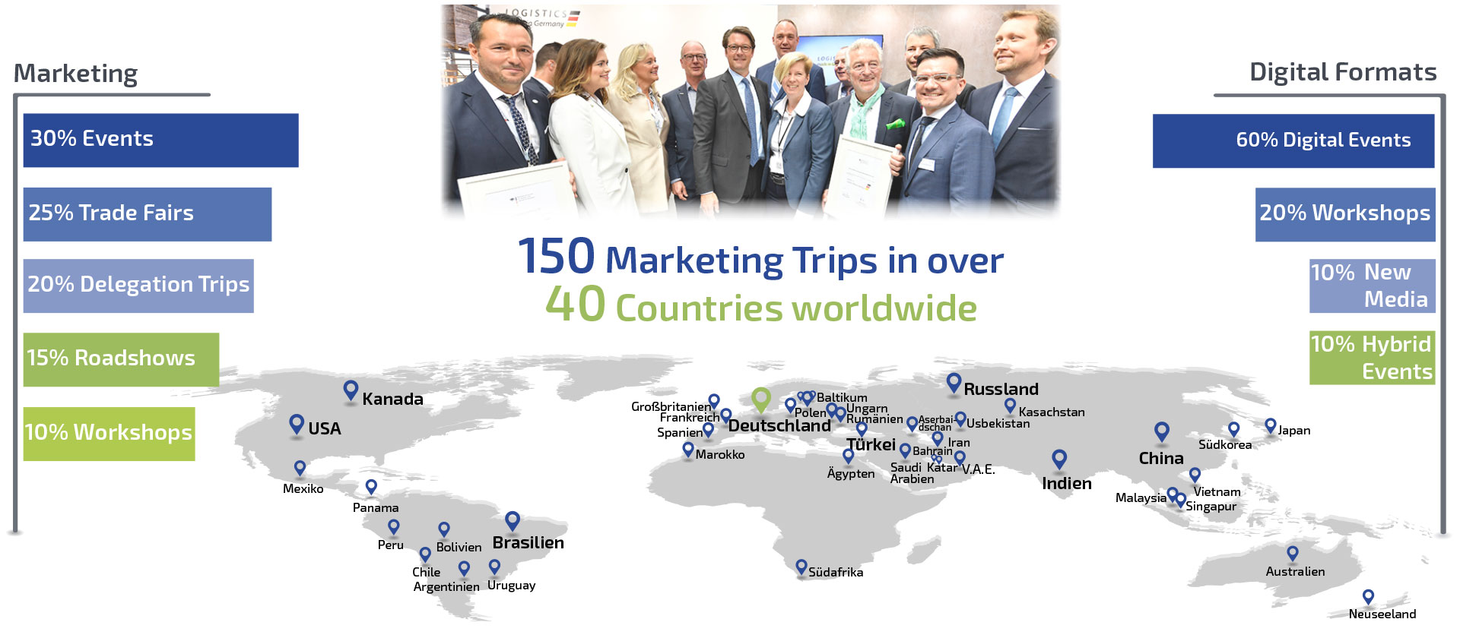
International Measures on behalf of Customers

Slide 15
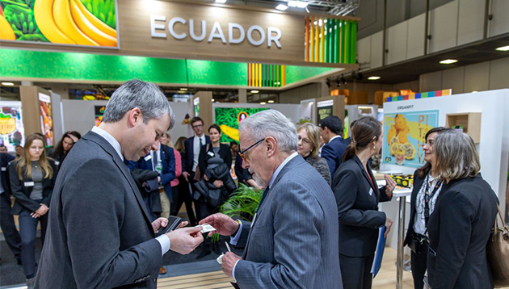
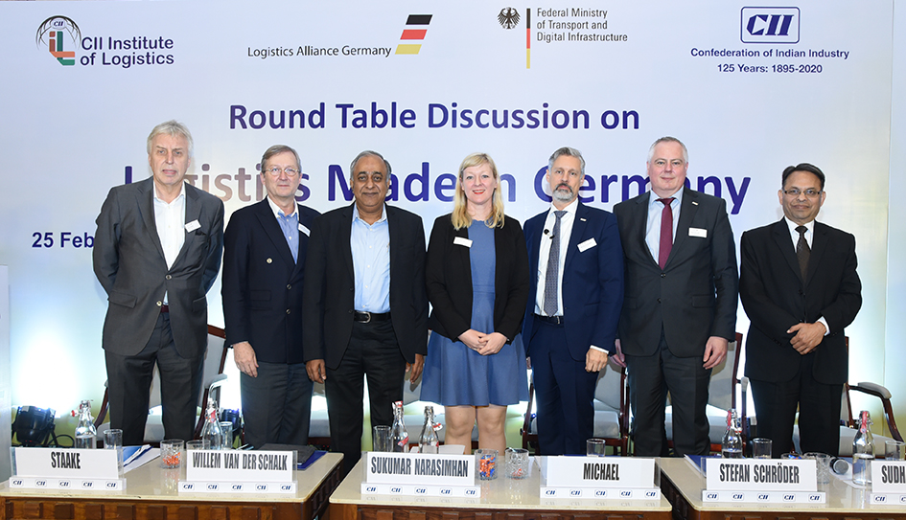
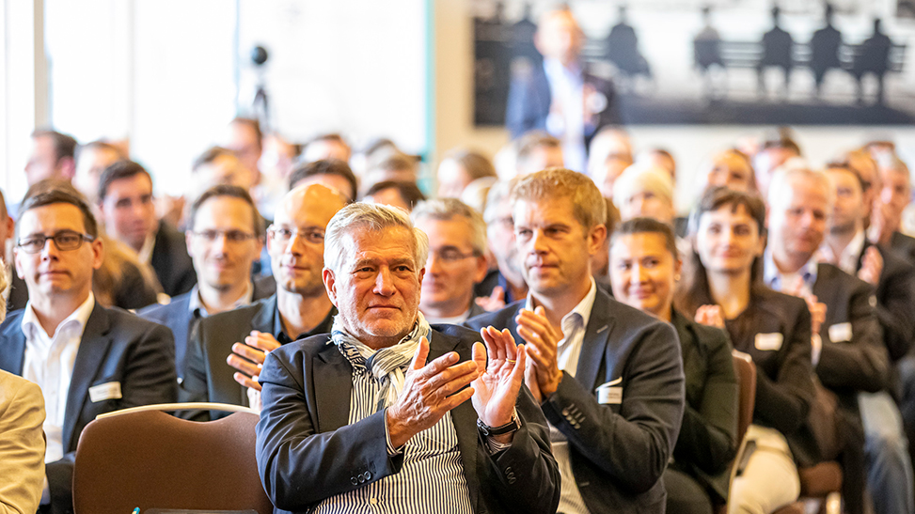
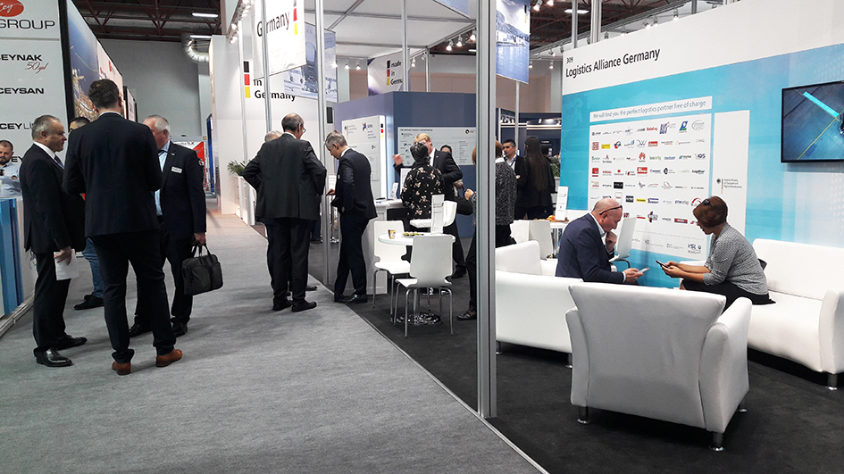
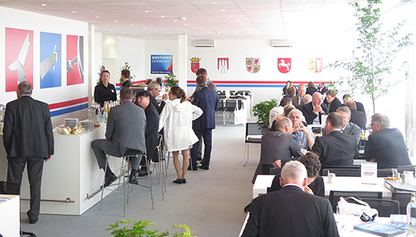
Excerpt References „Communication“
Fruit Logistica Berlin (2020)
Trade fair
Round Table Indien (2020)
Delegation trip
Trans4Log Congress (2019)
Congress
logitrans Istanbul (2019)
Trade fair
Quo Vadis (2019)
Networking event of LPN e.V.
ILA Berlin (2018)
Trade fair

Slide 16
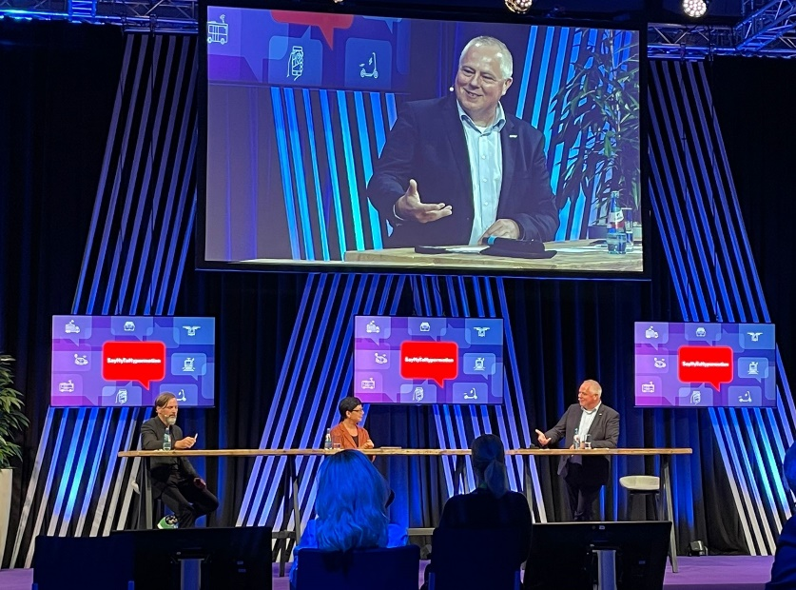
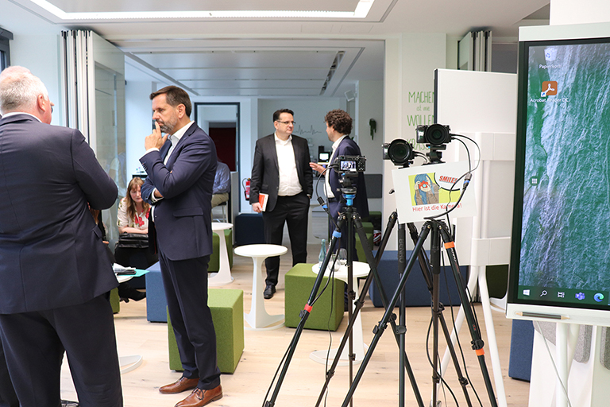
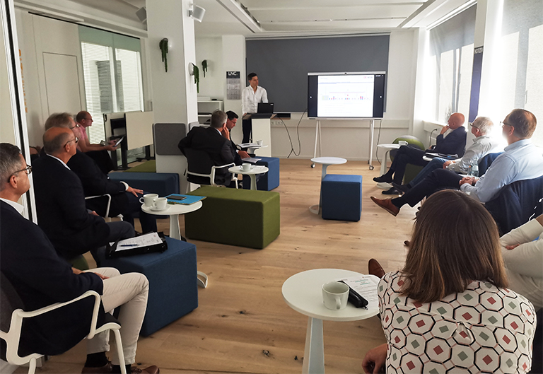
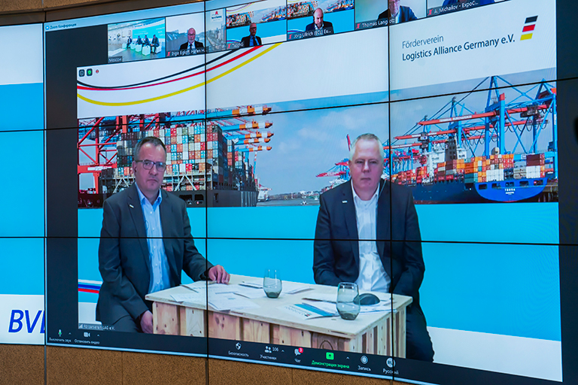
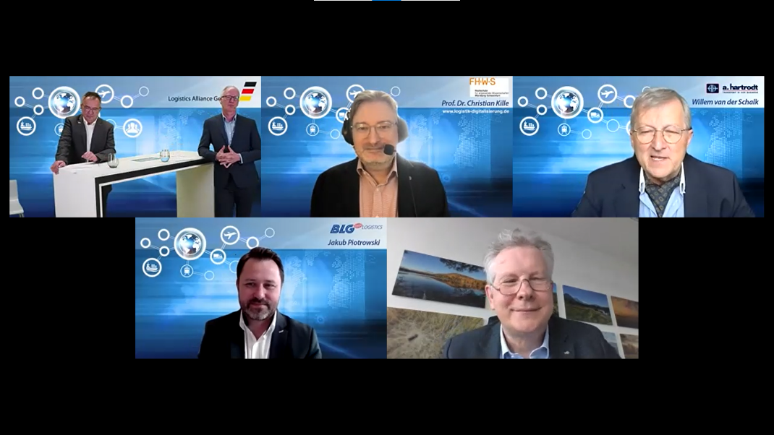
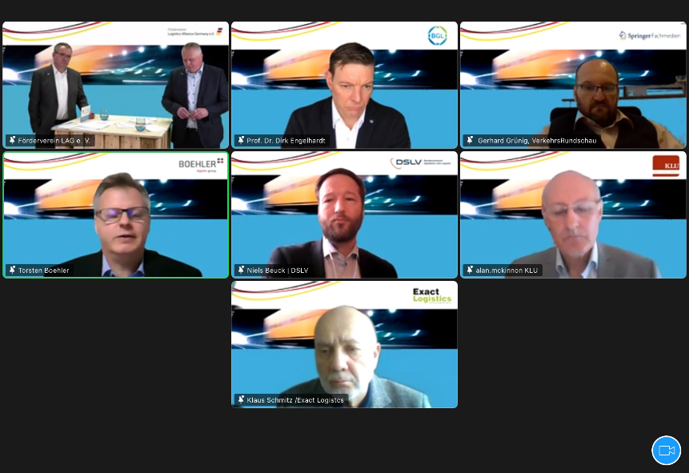
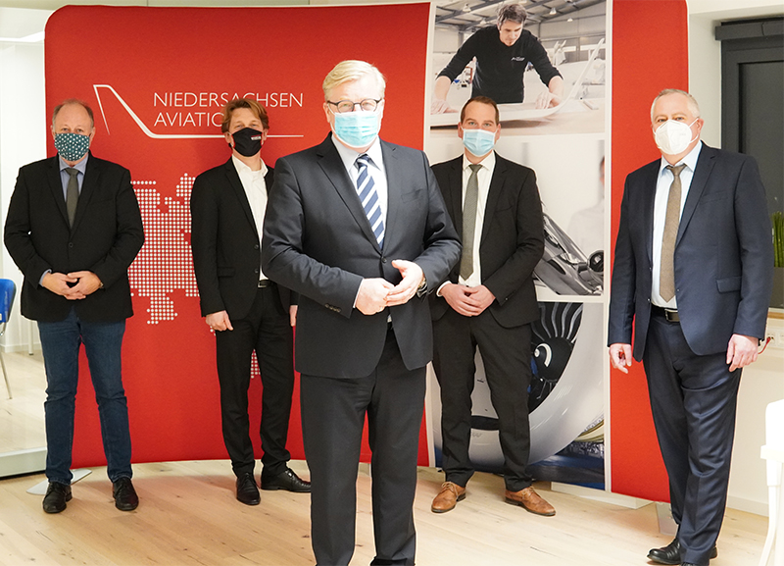
Excerpt „Digital und Hybrid Events“
Hypermotion Frankfurt (2021)
Hybrid Event with DAG: „Europa and the Silk Road“ (2021)
27th meeting of the GVZ working group (2021)
TransRussia Moscow (2021)
transport logistic Munich (2021)
Trans4Log Congress (2021)
German-British
Logistics Forum (2021)
Annual network meeting of the state initiative Niedersachsen Aviation (2020)

Slide 17
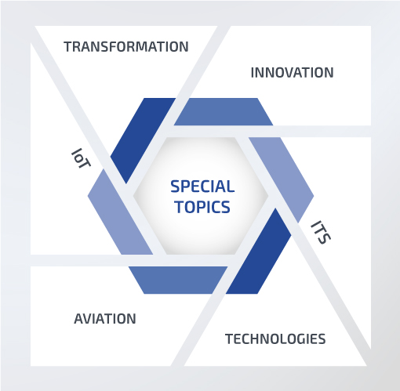
Special Topics
Selection of References:

Slide 18
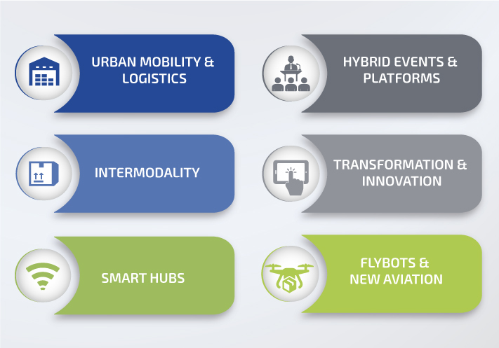
LNC- Current Topics
Mikro-Depots
Cargo Bikes
Combined transport and wagonload traffic
New Silk Road
Smart Warehouse
Smart Airport
LNC LIVE
TRANS4LOG
New Business
Design Thinking
Flight Taxi
Industry application

Slide 19
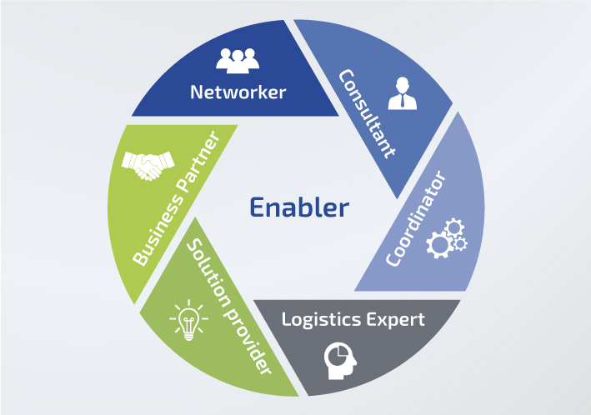
LNC – Logistics Consulting „made in Germany“
Leading topics in:
Urban Logistics & Intermodality
Customer focused:
Networks & Clusters
Solution-oriented:
Platforms & Events

Slide 20
LNC-Performance verses: Green | Lean | Smart
We create sustainable solutions for mobility and logistics that are efficient, powerful and innovative.

Slide 21
Contact
Stefan Schröder
Managing Director of the LNC
Georgsplatz 12
30159 Hannover
+49 (0)511 35 77 92 0
StS@LNC-Hannover.de
www.LNC-Hannover.de

Slide 22
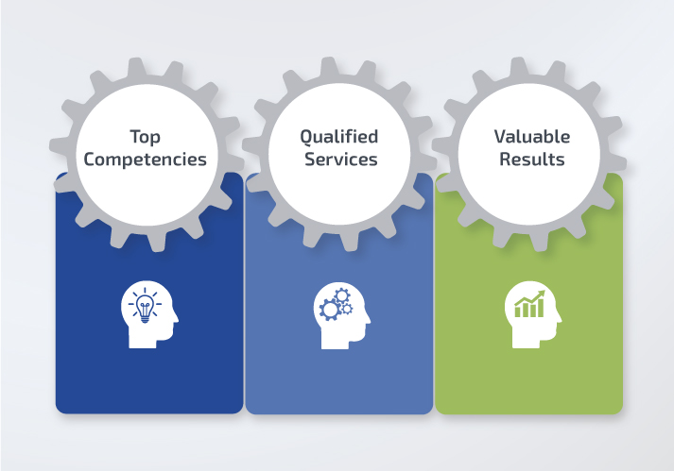
LNC-Stärken
Langjährige Expertise in diversen Bereichen und Projekten
Stark vernetzt: auf lokaler, regionaler, nationaler und internationaler Ebene
Starke Leistungsfähigkeit & hohe Serviceorientierung
Innovative und effiziente Lösungen

